Slide 1
Chapter 1軟體特性及軟體工程的範圍

Slide 2
課程說明
上課+實習
助教：陳家安
Office hour : 星期四下午14:00 – 17:00
評分
期中考+期末考：40%
三份報告：45%
需求規格書、設計規格書、測試報告+操作手冊
期末專題成果：15%
火車或高鐵訂票系統

Slide 3
軟體開發生命週期
使用者需求
使用者：我需要什麼
確認
理解
需求規格書
分析者：我提供什麼
產品
設備/電腦：執行結果
設計規格書
設計者：我要讓軟體做什麼
原始程式
軟體工程師：我要寫什麼

Slide 4
Topics covered
Important Characteristics of software
Purpose and scope of software Engineering
Professional and ethical responsibility

Slide 5
1.1軟體的重要特性

Slide 6
What is software?
Computer programs and associated documentation such as requirements, design models and user manuals.
Software products may be developed for a particular customer or may be developed for a general market.
Software products may be
Generic - developed to be sold to a range of different customers e.g. PC software such as Excel or Word.
Bespoke (custom) - developed for a single customer according to their specification.
New software can be created by developing new programs, configuring generic software systems or reusing existing software.

Slide 7
1 軟體是工具或娛樂性玩具
從軟體的用途/目的作軟體的分類
WORD. Window OS, 選課系統,手機內軟體等等,使用動機:提升工作效率/方便性 (工具)
但COMPUTER GAME? (娛樂)
TOOL or ENTERTAINMENT
工具:為何要用(目的)?什麼人用?何時用?如何用?得到什麼效益?
→產品成功的條件!

Slide 8
2 軟體是一個系統
系統:由一群相亙連結的組件( components)組成,共同運作以完成特定任務
任務的複雜性影嚮系統的複雜度及組件的數量
每一組件均有被使用的時機
一任務的每一工作由一或多個組件的正常運作來達成,多個組件間有連動關係
軟體是否具有上述性質?
組件:程式模組、資料模組(檔案、資料庫、資料結構)
大組件由一群小組件組成

Slide 9
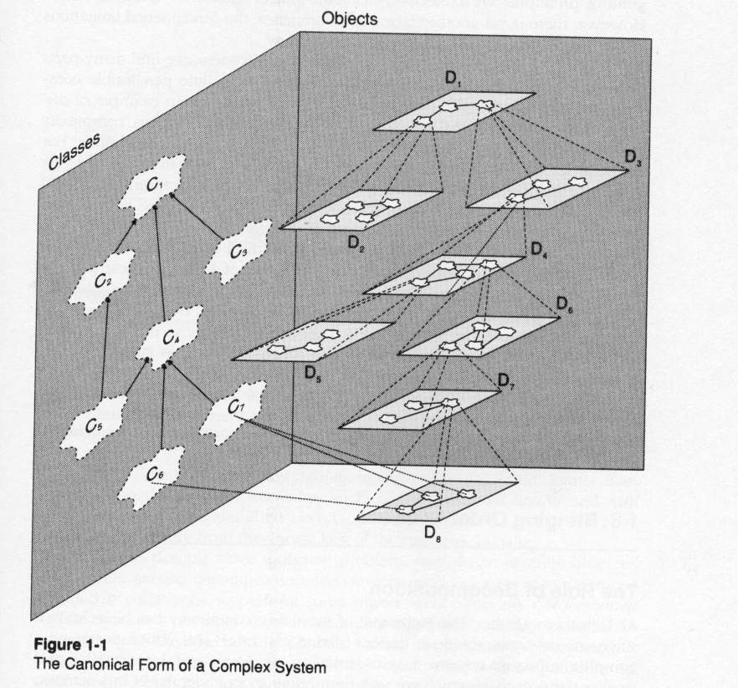

Slide 10
3 軟體不會磨損,只是不斷演進
軟體會讓你繼續用下去的理由: meet customer needs, high quality(助益大、好操作、可靠、等等)
軟體該停用的理由: 沒有價值!
Maintenance of bridge vs operating system
Bridge: painting, repair minor cracks, resurfacing road <--由磨損造成
OS: from batch to time sharing → change of architecture, lots of code should be rewritten. <--功能改變(更複雜!)

Slide 11
3 軟體不會磨損,只是不斷演進
Operating System vs Bridge
橋施工不良有什麼後果? →照用
軟體呢? wrong result, data loss, system crash
橋不當使用有什麼後果? →照用,只要不斷!
軟體不當使用呢? 允許使用的後果! →對策:無法操作,Use error or warning messages to remind the user or administrator

Slide 12
What are the attributes of good software?
The software should deliver the required functionality and performance to the user and should be maintainable, dependable and acceptable.
Maintainability
Software must evolve to meet changing needs;
Dependability
Software must be trustworthy;
Efficiency
Software should not make wasteful use of system resources;
Acceptability
Software must accepted by the users for which it was designed. This means it must be understandable, usable and compatible with other systems.

Slide 13
3 軟體不會磨損,只是不斷演進
軟體為何要修改?
操作不便、修改報表格式、錯誤 →修改程式
平台改變 →修改平台介面程式或調整架構
增加新功能→調整架構及增修改程式
Software maintenance:修改軟體以維持軟体正常運作且滿足客戶使用
More complicated for software than other engineering product

Slide 14
4 軟體內容包括程式碼與設計文件
修改軟體時,只有程式碼有何不便?
不知當時如何設計!
不易找出該修改處!
不易發現修改所造成的影嚮
軟體內容:程式碼與設計文件
使人了解設計的動機、功能、軟體架構、各模組設計方法
程式碼及所需 Data
測試環境、程式、資料、及步驟
建置、使用、維護文件

Slide 15
5 軟體是創意作品
軟体是為明天的使用而開發
使用者?用來作什麼?得到什麼效益?如何使用?
product requirements( i.e. what the users need) of a software at a time.
你會要求A公司設計B公司己有的產品嗎?
與其他使用者擁有相同競爭力
軟体高設計成本,低生產成本

Slide 16
5 軟體是創意作品
Requirements: what services the software should provide, constraints of services and development
Development of a software product is usually started from a vague concept. (模糊概念或想法)
Usually, user(s) is difficult to list all what he wants the system to do unless he know computer very well; developer(s) does not have enough domain knowledge to help user(s) to find out what services the software should provide to solve user’s problems.

Slide 17
6 軟體是高複雜性系統
影響軟體複雜度的因素:
供多不同類型的使用者使用
多使用者同時使用
多使用者同時使用,且相亙影響
多使用者分散各地同時使用
在多平台可使用
在限定時間內完成工作
不容許錯誤
不容許不當使用
…
…
與橋相比較

Slide 18
1.2 軟體工程的目的與範圍

Slide 19
Importance of software
More and more systems are software controlled
The economies of all developed nations are dependent on software.
Expenditure on software represents a significant fraction of GNP in all developed countries.
Software engineering is concerned with theories, methods and tools for professional software development.

Slide 20
What is software engineering?
Software engineering is an engineering discipline that is concerned with all aspects of software production.
Software engineers should adopt a systematic and organised approach to their work and use appropriate tools and techniques depending on the problem to be solved, the development constraints and the resources available.

Slide 21
Why Software Engineering is needed?
Software should be developed within limit of budget, and on time.
Characteristics of software development
Knowledge-intensive job
Team work
Coordination of people task and progress is very important
Software engineering is concerned with cost-effective software development.

Slide 22
Learning experience
Different approaches affect the capability to build complex house.
Different modeling technique
Different verification technique
Different method→ affect process and management
Different tools
Key issues of software engineering research
了解問題的起因、性質、限制條件、及預期結果，進而思考可能的解決策略(類比法是一種參考作法)，進行不同解決策略的評估，再探討解決方法,最後分析方法的實用性

Slide 23
Definition of Software Engineering
[Fritz Bauer] Software engineering is the establishment and use of sound engineering principles in order to obtain economically software that is reliable and works efficiently on real machines
[IEEE] Software engineering:(1) The application of a systematic, disciplined, quantifiable approach to the development, operation, and maintenance to software, that is, the application of engineering to software. (2) The study of approaches as in (1).

Slide 24
軟体工程的範圍
基本目的:熟知軟體生命周期及成熟的軟體開發方法,進而運用它來開發新軟體
研究
新的approach
新的methodology
新的method
新的process
新的tool
新的提升軟體開發效率與品質的機制與理論

Slide 25
What is a software process?
A set of activities whose goal is the development or evolution of software.
Generic activities in all software processes are:
Specification - what the system should do and its development constraints
Development - production of the software system
Validation - checking that the software is what the customer wants
Evolution - changing the software in response to changing demands.

Slide 26
What are software engineering methods?
Structured approaches to software development which include system models, notations, rules, design advice and process guidance.
Model descriptions
Descriptions of graphical models which should be produced;
Rules
Constraints applied to system models;
Recommendations
Advice on good design practice;
Process guidance
What activities to follow.

Slide 27
What we should learn?
Software engineering theory & methods
Software development process
Software project management

Slide 28
What is a software process model?
A simplified representation of a software process, presented from a specific perspective.
Examples of process perspectives are
Workflow perspective - sequence of activities;
Data-flow perspective - information flow;
Role/action perspective - who does what.
Generic process models
Waterfall;
Iterative development;
Component-based software engineering.

Slide 29
What is CASE (Computer-Aided Software Engineering)
Software systems that are intended to provide automated support for software process activities.
CASE systems are often used for method support.
Upper-CASE
Tools to support the early process activities of requirements and design;
Lower-CASE
Tools to support later activities such as programming, debugging and testing.

Slide 30
Terminology
Methodology(方法論) and paradigm(典範)
Both are a collection of techniques for carrying out the complete life cycles
Methodology: science of methods
Paradigm: a model or pattern
Method: for a phase, part of a phase
Process: Guidelines and procedures, scaled up from method, are applied to projects with many interacting activities and parties. →Many people can work simultaneously.

Slide 31
Terminology
Tool: to improve the efficiency of development, based on method
Tool sets: Workbench, environment
Workflow
Use of previous phase artifact
Check of consistency, redundancy, completeness, error.
Automatic or semi-automatic

Slide 32
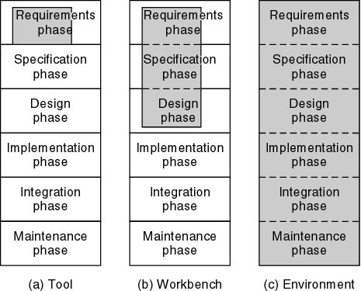

Slide 33
1.3 Professional and ethical responsibility

Slide 34
Professional and ethical responsibility
Software engineering involves wider responsibilities than simply the application of technical skills.
Software engineers must behave in an honest and ethically responsible way if they are to be respected as professionals.
Ethical behaviour is more than simply upholding the law.

Slide 35
Issues of professional responsibility
Confidentiality
Engineers should normally respect the confidentiality of their employers or clients irrespective of whether or not a formal confidentiality agreement has been signed.
Competence
Engineers should not misrepresent their level of competence. They should not knowingly accept work which is outwith their competence.

Slide 36
Issues of professional responsibility
Intellectual property rights
Engineers should be aware of local laws governing the use of intellectual property such as patents, copyright, etc. They should be careful to ensure that the intellectual property of employers and clients is protected.
Computer misuse
Software engineers should not use their technical skills to misuse other people’s computers. Computer misuse ranges from relatively trivial (game playing on an employer’s machine, say) to extremely serious (dissemination of viruses).

